Slide 1
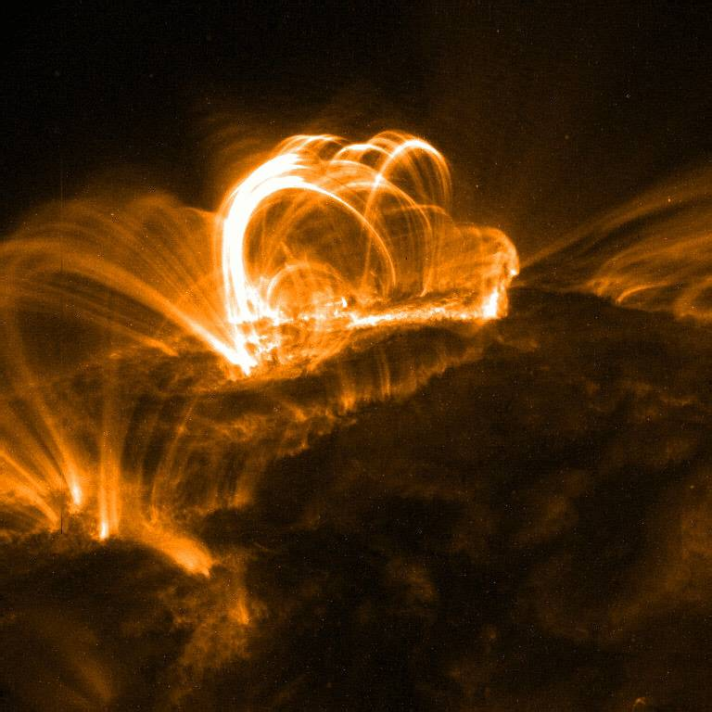
X-Ray Solar Flare Analysis
By: Chris Moore
Mentor: Brian Dennis
NASA Goddard Space Flight Center
SESI program

Slide 2

Outline
Solar Flares
Research objectives
RHESSI
Methodology
Results
Conclusion

Slide 3

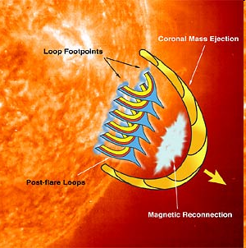
Dynamics of Solar Flares
Energy stored in magnetic field
Magnetic reconnection releases energy
  Accelerated
    Electrons
    Ions
  Gas heated to tens of MK
This gives rise to the two phases of solar flares
Notes:
One Theory on the Trigger of Solar Flares is…

Slide 4

Dynamics of Solar Flares 2
Impulsive Phase
  Electrons emit hard X-rays (>20 keV)
  Heat gas in chromosphere
Gradual Phase
  Hot gas emits soft X-rays (<20 keV)
Release energy up to billions of atomic bombs
Notes:
The magnetic reconnection forces material back into the solar atmosphere…

Slide 5
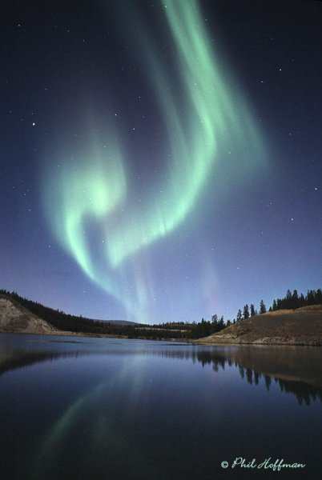
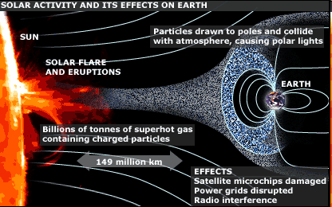
Solar flares effect on Earth
Particle events
  Auroras
Geomagnetic storms
  Power grids
  Airlines (rerouting for polar flights)
  Disruptions
    GPS
    Radio blackouts
    Cell phones
Space weather
  Flares
  CME’s
  Solar Wind
  SEPs

Slide 6
Research objectives
Energy determination
  Non-thermal accelerated electrons
  Plasma at thermal peak

Slide 7

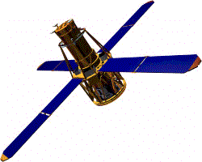
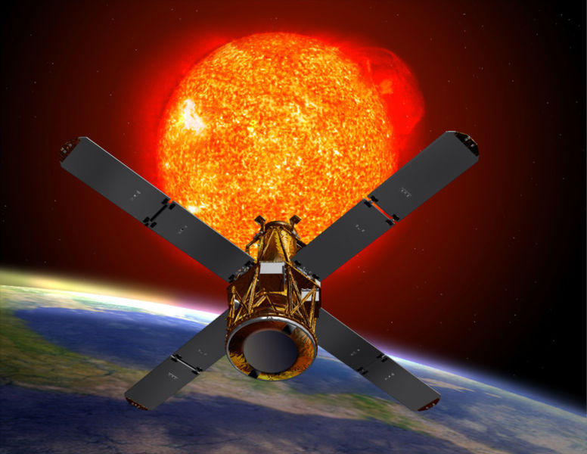
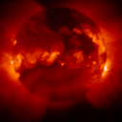
RHESSI
(Rauven Rhamaty High Energy Spectroscopic Solar Imager)
3 keV - 17 MeV (0.4 - 6 x 10⁻⁵ nm)
~ 1 keV spectral resolution
4 second temporal resolution
~ 2’’ spatial resolution

Slide 8
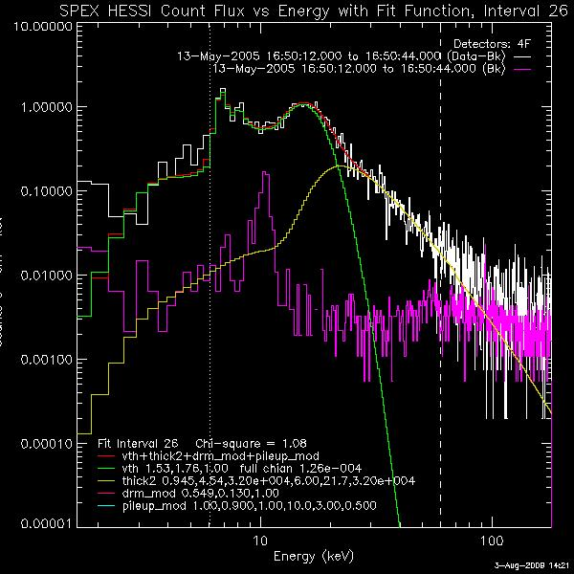
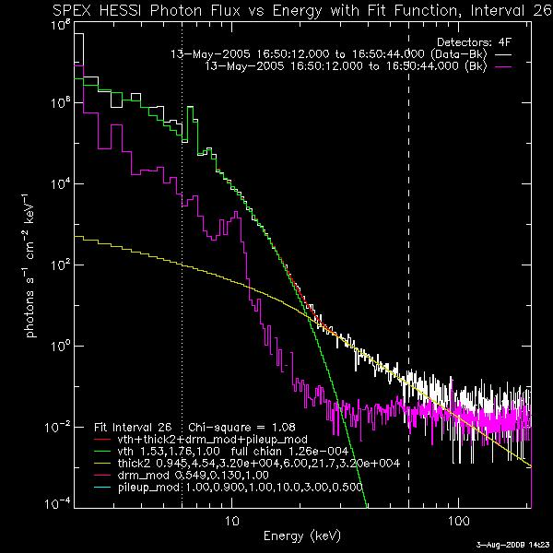
Spectrum Fitting

Slide 9
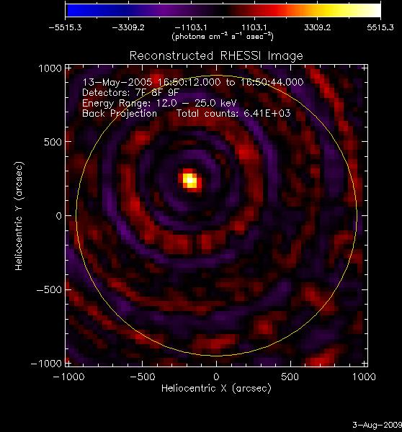
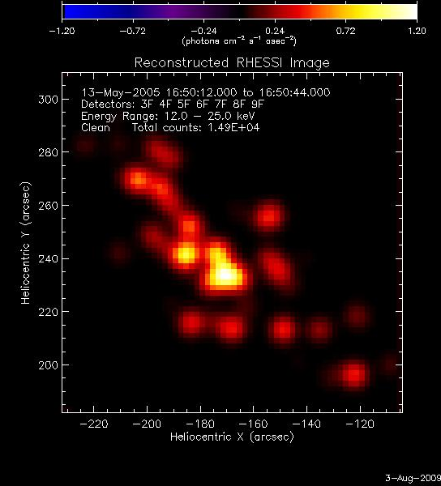
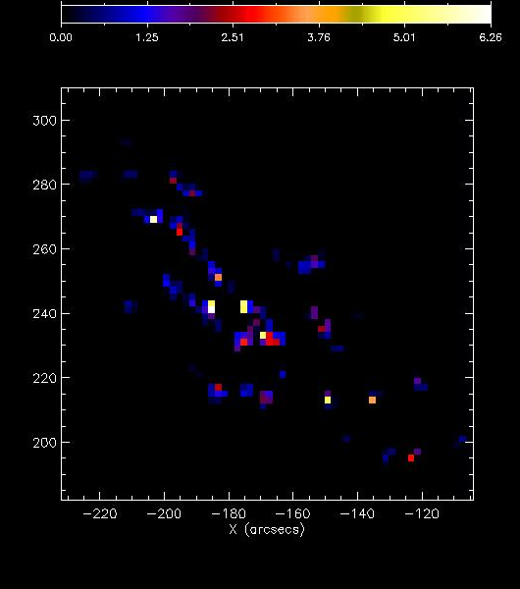
Imaging

Slide 10
Some Results
13-May-2005 (M8.0) (N12, E11)
  Non-thermal electrons
    1.3 x 10³¹ ergs
  Thermal Peak
    1.4 x 10³⁰ ergs +/- 6 x 10²⁹
Over 30 flares analyzed

Slide 11
Future Work
Looking forward for next solar cycle
Expand analysis
Alternative imaging techniques

Slide 12
References
The Reuven Ramaty High-Energy Solar Spectroscopic Imager (RHESSI)- Mission Description and Early Results, Robert P. Lin, Brian R. Dennis, and Arnold O. Benz.
Energy Partition in two solar flare/CME events, Emsilie, A.G., et al. (2004) J. Geophys. Res., 109, A10104, doi:10.1029/2004A010571
Refinements to flare energy estimates, Emsilie, A. G., B. R. Dennis, G. D. Holman, and H. S. Hudson (2005) J. Geophys. Res. 110, A11103, doi; 10. 1029/2005JA011305
Hard X-Ray Flare Source Sizes Measured with the Ramaty High Energy Solar Spectroscopic Imager, Dennis, B. R., Pernak, R. L.

